Slide 1
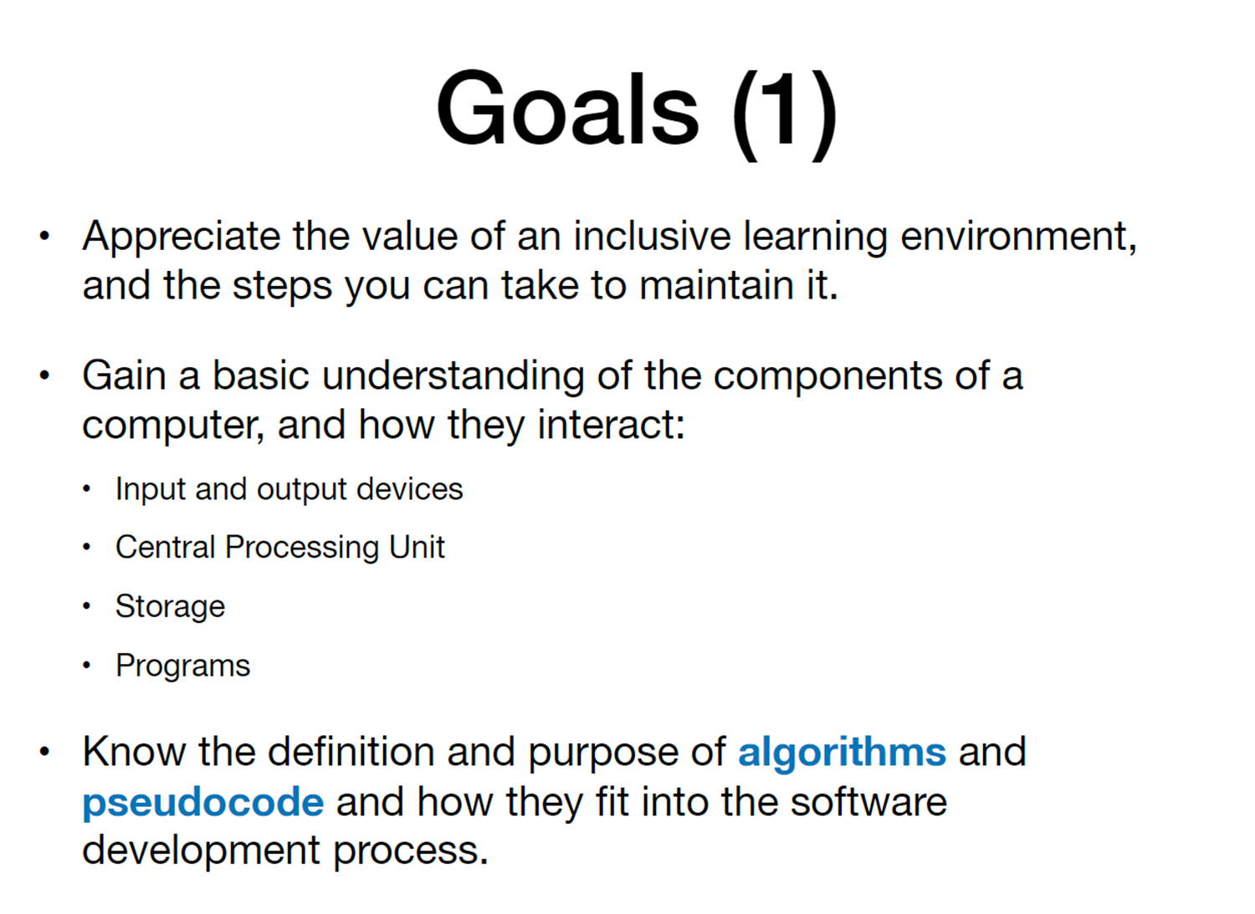

Slide 2
Try to fill out the chart on the next slide: guesses are ok!

Slide 3
Type | What it looks like | How it works by itself | How it works with other parts | Measured (bigger? Faster?)
Input devices
Output devices
Memory
Storage
Processor

Slide 4
Type | How it works by itself | How it works with other parts | Measured (bigger? Faster?)
Memory RAM (random access memory)
Storage HDD (Hard disk drive) SSD (solid state drive)
Processor CPU Central processing unit

Slide 5
pcpartpicker.com/list

Slide 6
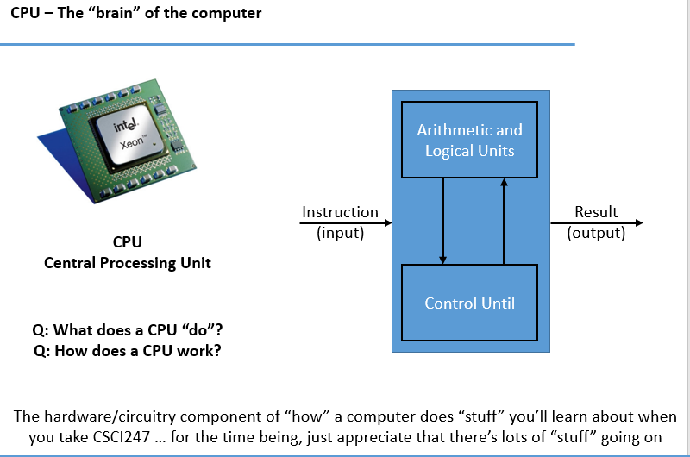

Slide 7
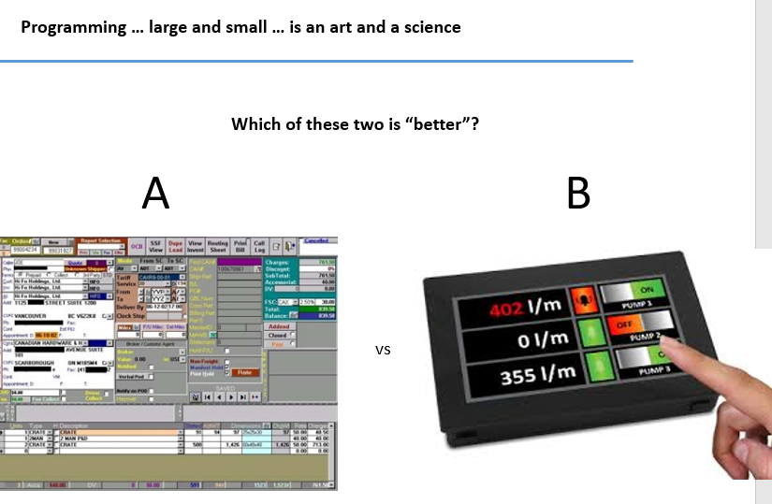

Slide 8
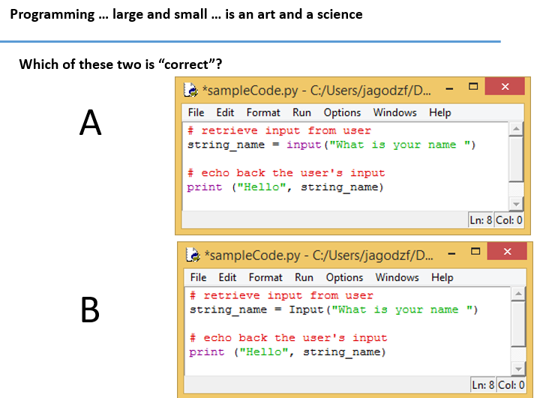

Slide 9
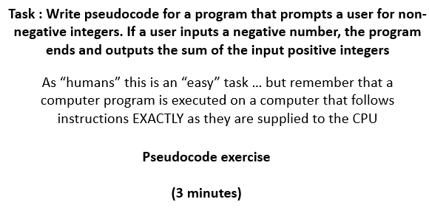

Slide 10
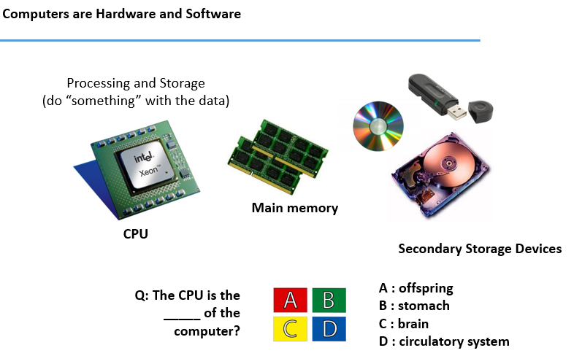

Slide 11
